Slide 1


Slide 2


Slide 3

Notes:
There are seven guiding principles for the Medical Training Survey:
1. Quality improvement: The MTS is a quality improvement tool, to strengthen medical training in Australia.
2. Safe and confidential: Medical trainees and supervisors can safely and confidentially participate in the MTS. Participants’ data will be de-identified in any reporting of results, and only de-identified data will be provided to the Board and AHPRA.
3. Focused on training: The core focus of the NTS is on post-graduate medical training.
4. Reflection and feedback: The MTS encourages participants to reflect on their medical training and teaching and provide feedback safely to support continuous improvement. Reflective practice is a cornerstone of good medical practice and of the Professional Performance Framework.
5. Access: The MTS will be relevant to medical training and not onerous to complete. It will be accessible online and easy to use, to encourage participation.
6. Reporting and using results: The results of the MTS will be published in the interests of transparency. Specialty and jurisdiction specific reports from MTS data will be generated as far as possible, while assuring participant confidentiality. Stakeholders will apply survey results to improve medical training.
7. Participation: The annual MTS will evolve, initially seeking feedback from doctors in training and in time their supervisors. It aims to reduce the need for other surveys about the same issues.

Slide 4

Notes:
MTS was the idea of doctors in training, educators and employers
It is the result of a joint effort from doctors in training, specialist colleges, employers, health departments, educators, the AMA, Doctors’ Health Services, Postgraduate Medical Councils, Australian Indigenous Doctors’ Association, the AMC , the Medical Council of NSW, the Medical Board and AHPRA.
The Medical Board of Australia and AHPRA are making it happen.
The Medical Board established a Steering Committee and an Advisory Group to support the development of the survey.
The advisory group includes representatives from doctors in training, jurisdictions, Australian Medical Association, Australian Medical Council, Australian Indigenous Doctors’ Association, Doctors Health Services, Directors of Clinical Training, Postgraduate Medical Councils, Medical Deans of Australia and New Zealand and the Medical Board

Slide 5
Notes:
Therefore the NTS was separated into 5 streams.
Interns
Prevocational and unaccredited trainees
Specialist trainees (non-GP)
Specialist GP trainees
IMGs
Most questions are common across all surveys, the rest are tailored to each group of junior doctors.
The MTS builds on existing junior doctor surveys by jurisdictions and colleges
The MTS will generate national, cross profession data that can be used to improve medical training.

Slide 6

Notes:
Survey questions fall into six broad topics and ask for junior doctor feedback on the following issues:
Demographic
Training program curriculum
Training program assessment
College engagement with trainees
Workplace environment and culture
Access to teaching
Clinical supervision
Training post orientation
Wellbeing
Patient safety
Overall satisfaction
Future career intentions
About you
Survey questions are tailored to the needs of each group of junior doctors.

Slide 7
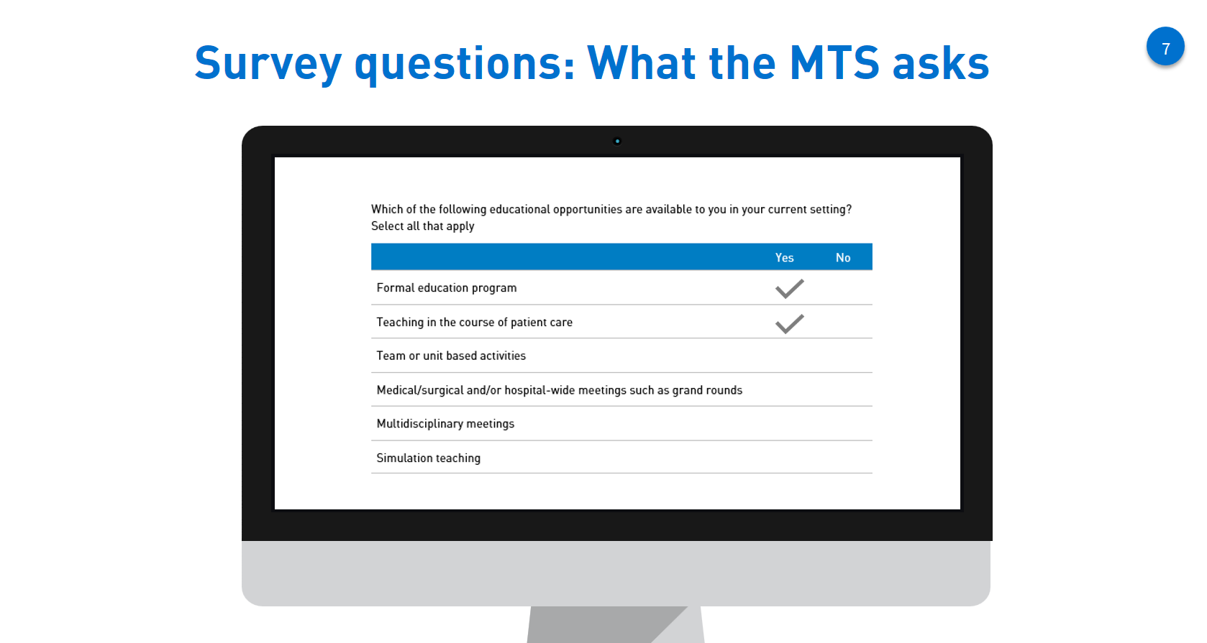
Notes:
No free text box
All multiple choice – some yes no answers; some likert scale
About 50 questions per survey
Takes 10 – 15 minutes

Slide 8
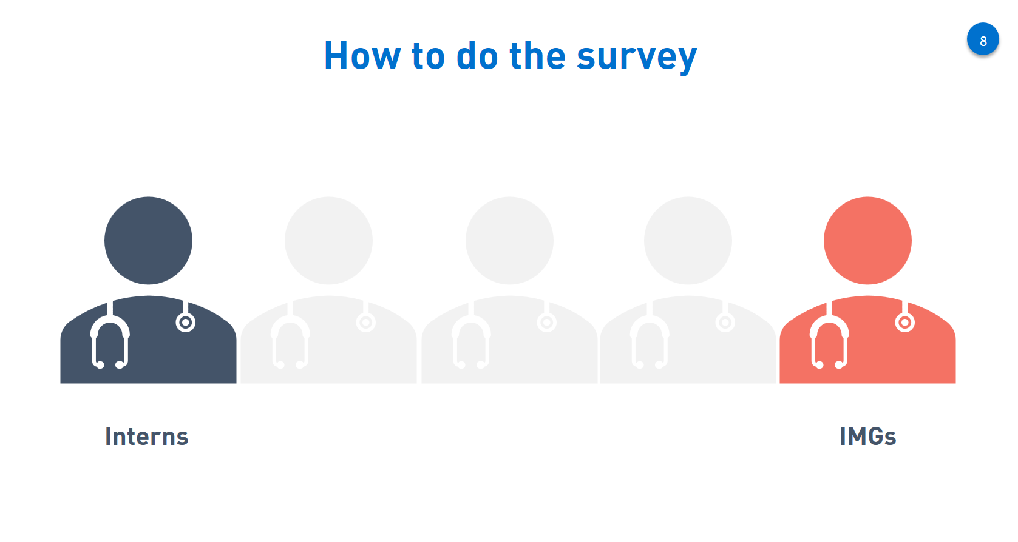
Notes:
Two options to participate:
Interns and IMGs will get an email from the Medical Board of Australia with a unique survey link

Slide 9

Notes:
Two options to participate:
Interns and IMGs will get an email from the Medical Board of Australia with a unique survey link

Slide 10
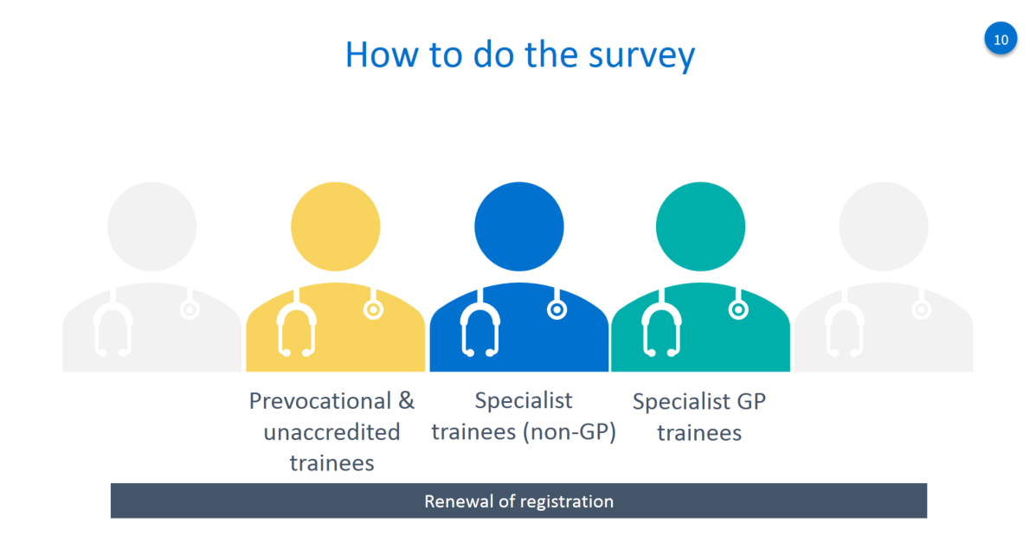
Notes:
All other groups of junior doctors do the survey when they renew their medical registration in August – September:
First register
Then do the Workforce Survey
Then do the Medical Training Survey.

Slide 11

Notes:
There will be a dedicated website to the MTS that will be accessible after the 25 July.
Includes information about the survey, will include the results
All you need to know about the Survey is published on the website!

Slide 12
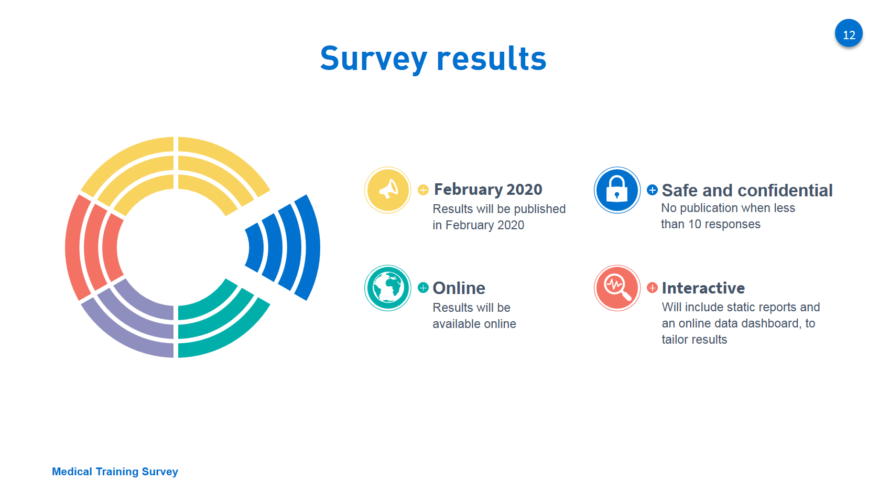

Slide 13

Notes:
MTS data will be:
Published in static reports and accessible through an interactive online dashboard
The dashboard will be easy to navigate and use
Will have comparison with national averages (optional)
Not display any data when there is <10 responses for that question
Reports will include detailed analysis for the national questions
Tailor reports by using optional filters:
State/Territory
Hospital/non-hospital
Remote, rural and metropolitan
Type of doctor in training (Interns, prevocational trainees, Specialist non-GP trainees, Specialist GP trainees, IMGs)
Specialist medical college
Gender
Post Graduate Year

Slide 14

Notes:
The importance of communication – do it and tell your friends, colleagues and trainees to do it
The more junior doctors who do the survey, the richer and more complete the data.
Please encourage doctors in training to do the survey.
The MTS builds on existing junior doctor surveys by jurisdictions and colleges
The MTS is the only survey that will generate national, cross profession data that can be used to improve medical training.

Slide 15
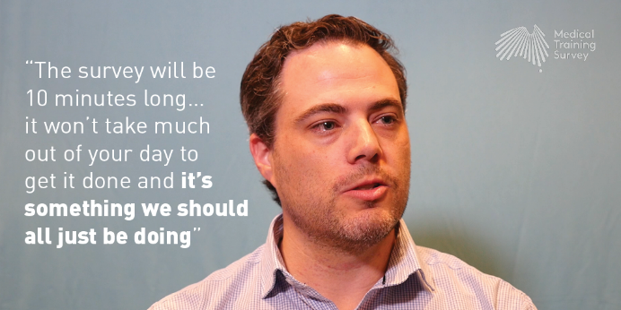
Notes:
Your colleagues are encouraging you to complete the survey. It is important we hear from everyone.

Slide 16

Notes:
Your colleagues are encouraging you to complete the survey. It is important we hear from everyone.

Slide 17
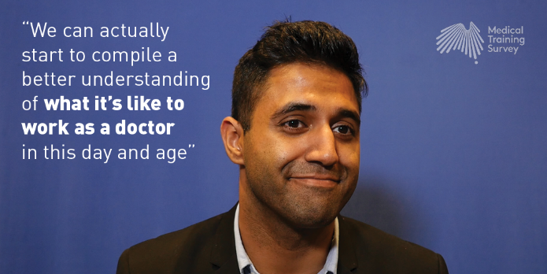
Notes:
Your colleagues are encouraging you to complete the survey. It is important we hear from everyone.

Slide 18

Notes:
Your colleagues are encouraging you to complete the survey. It is important we hear from everyone.

Slide 19


